Slide 1

AI FAIRNESS 360: AN EXTENSIBLE TOOLKIT FOR DETECTING, UNDERSTANDING, AND MITIGATING UNWANTED ALGORITHMIC BIAS Bellamy et al.
-Jie Hua and Shubham Sharma

Slide 2
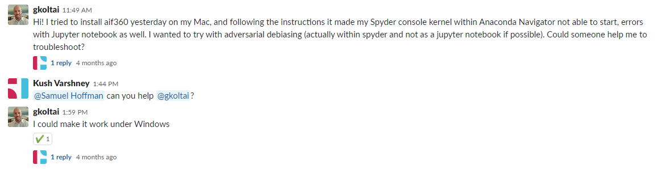
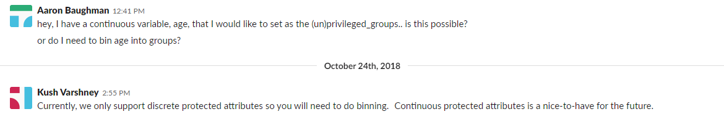
How user-friendly is it?

Slide 3
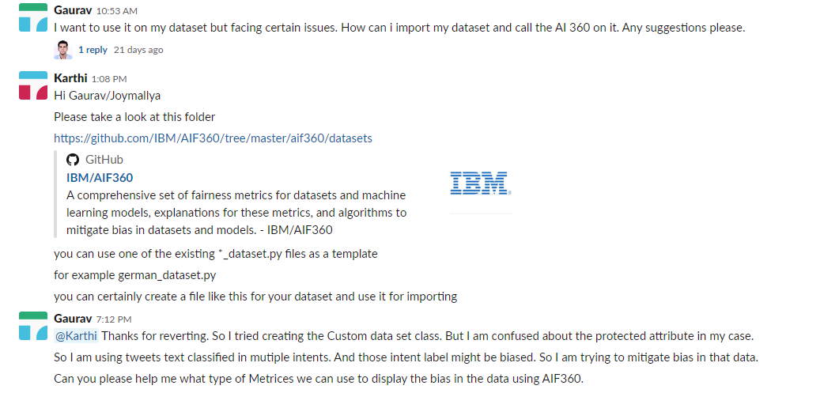
How user-friendly is it?

Slide 4
Assumptions and limitations of difference fairness methods
Optimized Pre-Processing for Discrimination Prevention: Should work for more than one protected attribute but doesn’t and for a new dataset, you'll need to define a distortion function.
A user reported that using one of the pre-processing fairness techniques made their dataset less fair.
Some methods that are said to work for non-binary or multiple features are only implemented for the binary case. Eg removing disparate impact

Slide 5
Compatibility issues
Lack of compatibility with scikit-learn pipeline.
Users need to change/customize their code to be able to use the toolkit.
Notes:
AI fairness is not very compatible with other ML tool sets like scikit-learn. If the user want to use the function like gridsearchCV in sklearn then he cannot use the model supported in AIF 360. For example, this user reported that the transformer class is incompatible with sklearn.

Slide 6
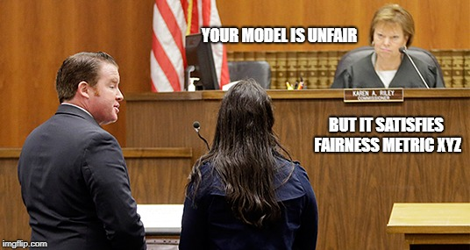
Philosophical discussion
How to agree on the metrics for fairness metrics?
Proxy vs human guided

